Slide 1


ONLINE MOVIE TICKET BOOKING SYSTEM
Faculty Coordinator:
Prof. Mosam Pandya
Head of Department:
Prof. Ami Patel
HoD, SY CE/IT-II
Prepared By:-
Student 1 Name: Akhani Yash JitendraKumar
Roll no: 55
Enrollment No: 22002170120002
Batch: F2 Branch: CE
Student 3 Name: Prajapati Pratik RamanikBhai
Roll no: 51
Enrollment No:
Batch: F2 Branch: CE
Student 2 Name: Raval Dinesh KaushikKumar
Roll no: 79
Enrollment No: 22002170220035
Batch: F2 Branch: IT
Student 4 Name: Shah Jeel JayeshKumar
Roll no: 53
Enrollment No: 22002170220042
Batch: F2 Branch: IT

Slide 2
Abstract:-
The proposed system is an online platform for movie ticket booking that utilizes JSON and Tkinter in Python.
The system aims to provide users with a seamless and user-friendly experience for booking movie tickets online.
The system will allow users to search for movies, select seats, and purchase tickets.
The system will use JSON for storing and retrieving movie data such as movie titles, showtimes, and available seats.
Tkinter will be used to create the graphical user interface (GUI) for the system.
Users will be able to interact with the system through the GUI, selecting their desired movie, showtime, and seats.
The proposed system is expected to enhance the user experience of online movie ticket booking, making it more accessible and convenient.

Slide 3
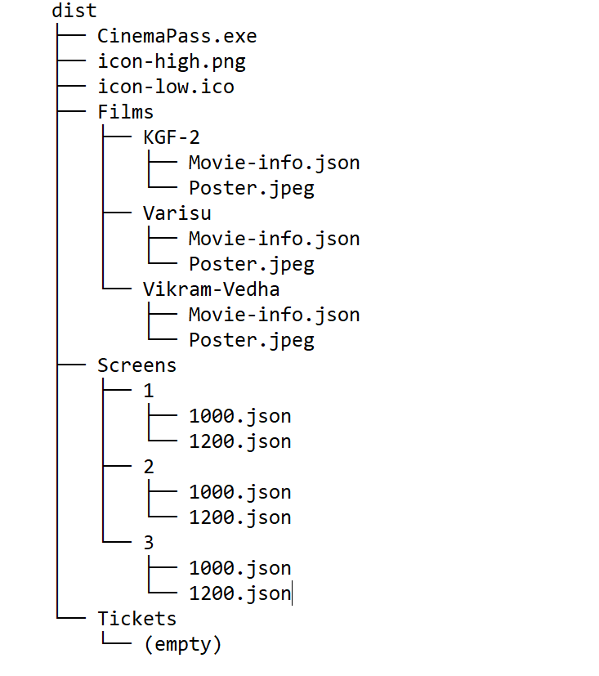
File Structure:-
Here is a breakdown of the file structure:-

Slide 4
Working:-
1.Navigate to the dist directory and run CinemaPass.exe.
2.Once launched, enter your name and phone number when prompted.
Make sure to enter your phone number accurately as it will be used to generate a
unique JSON file in the Tickets folder.
3.After entering your details, you will be presented with a list of available films.
4.Select your desired film from the list.
5.Choose your preferred showtime for the selected film.
6.Select your seats for the chosen showtime.
7.After selecting your seats, click the "Book" button to confirm your booking.
8.Your booking details will be saved in a JSON file in the Tickets folder with the
phone number you provided.
9.Enjoy your movie with CinemaPass!

Slide 5
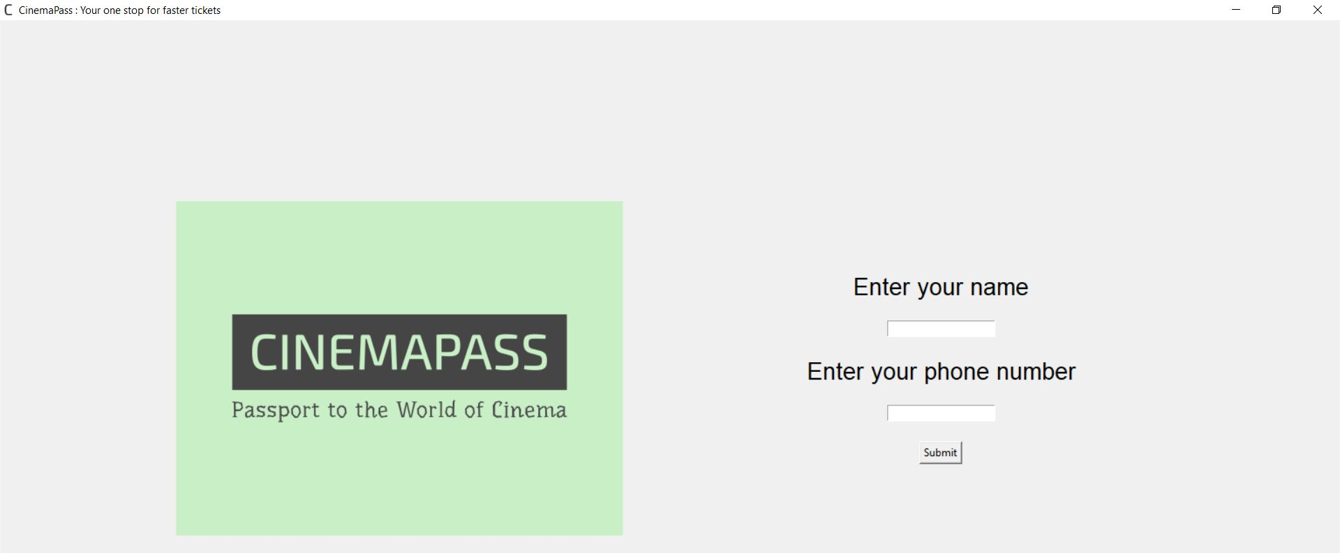
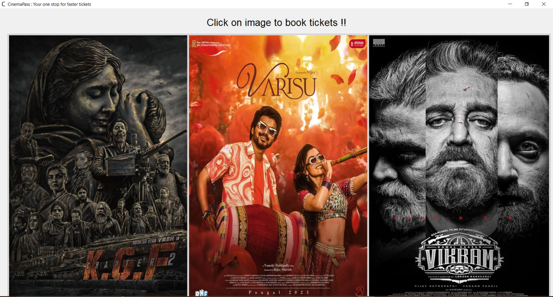
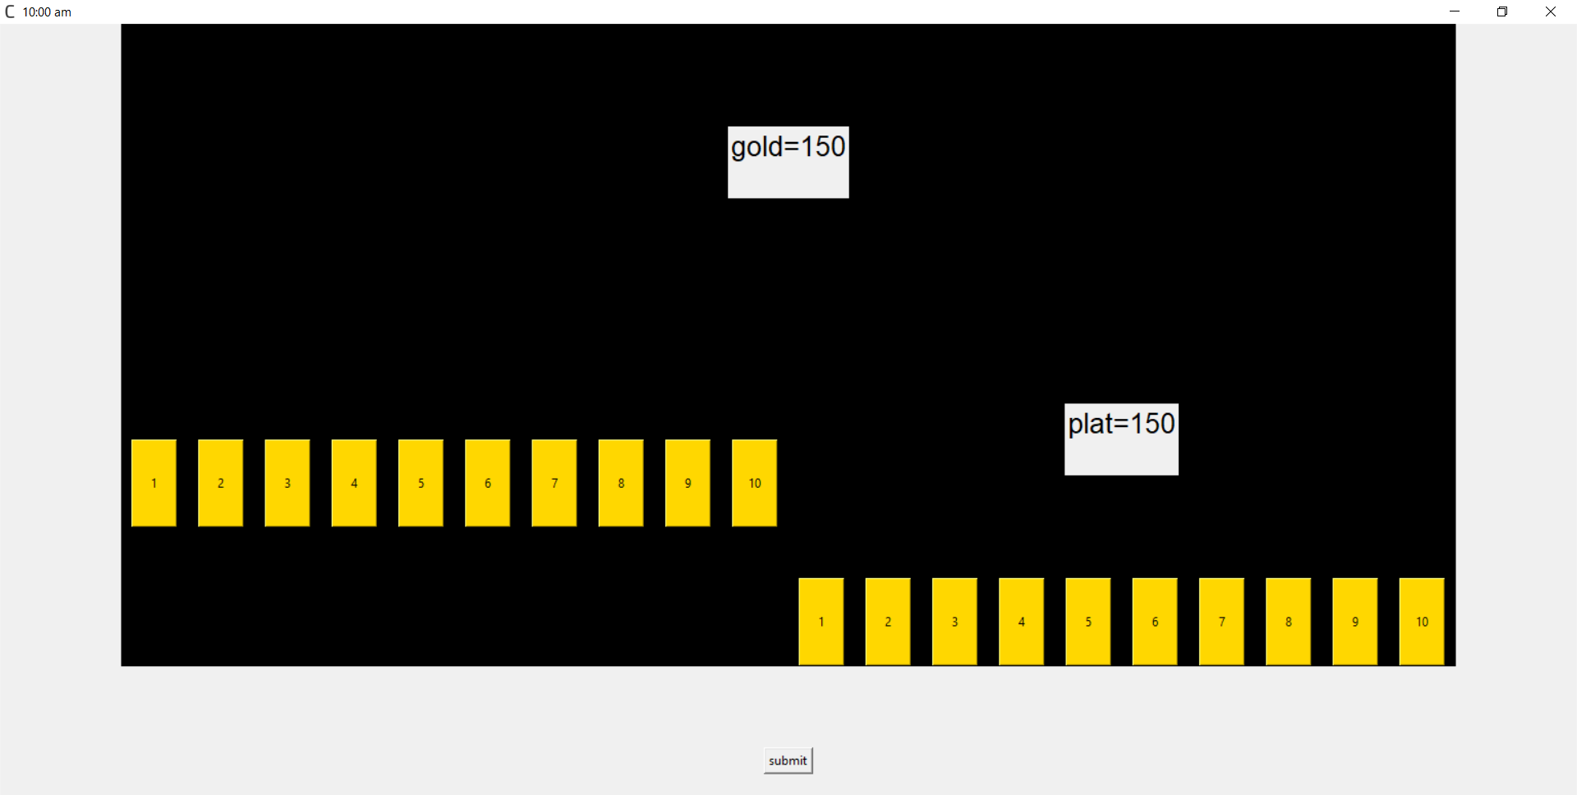
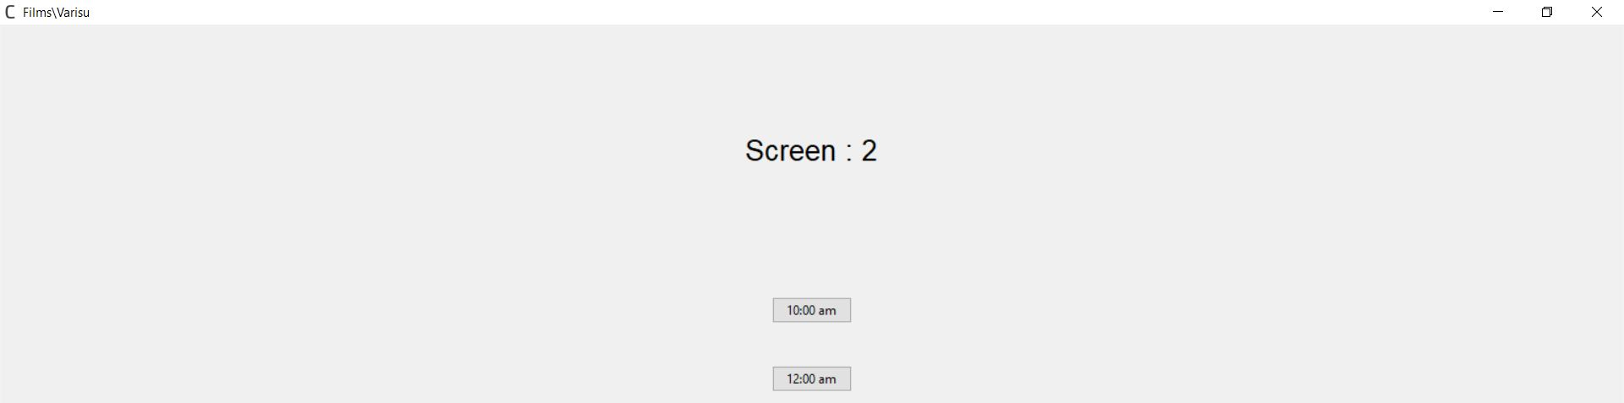
Output:-

Slide 6
REFERENCES:-
Software: Python 3.9
IDE:
- Anaconda/Jupyter(Python 3.9)
https://www.anaconda.com/products/distribution
- PyCharm(Version: 2022.3.2),
https://www.jetbrains.com/pycharm/
Websites:
https://www.w3schools.com/python/python_reference.asp
https://www.geeksforgeeks.org/python-programming-language/
https://realpython.com/
https://www.python.org/

Slide 7
Thank you…

